Slide 1
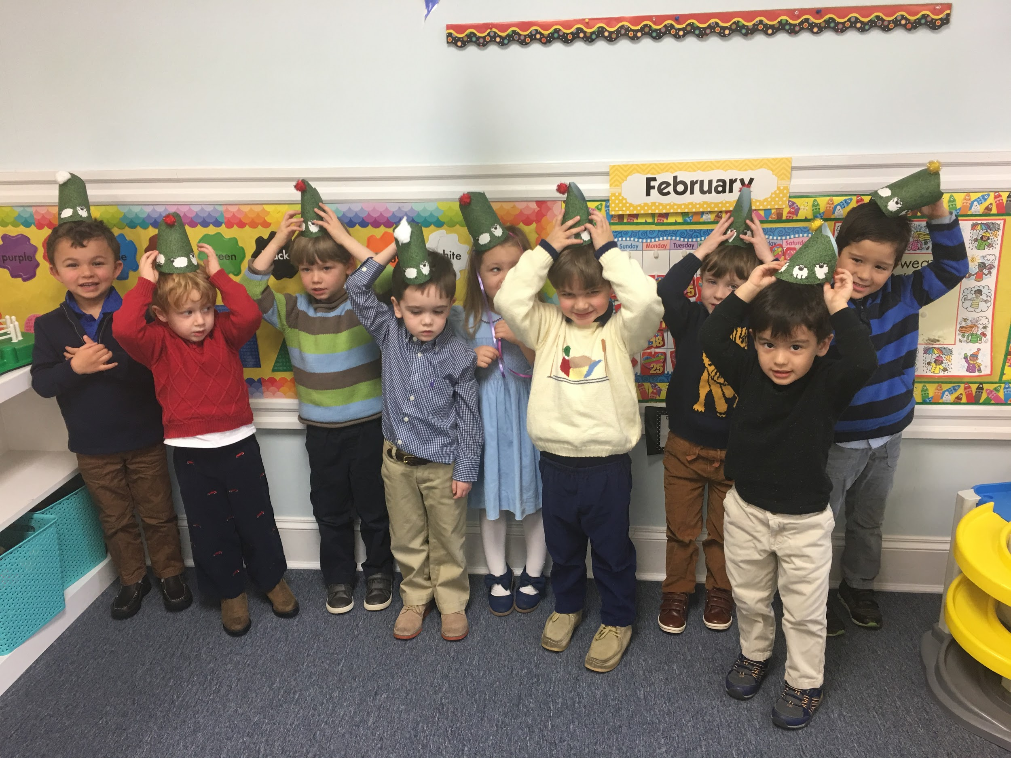
Safe Sanctuaries Training
First United Methodist Church

Slide 2
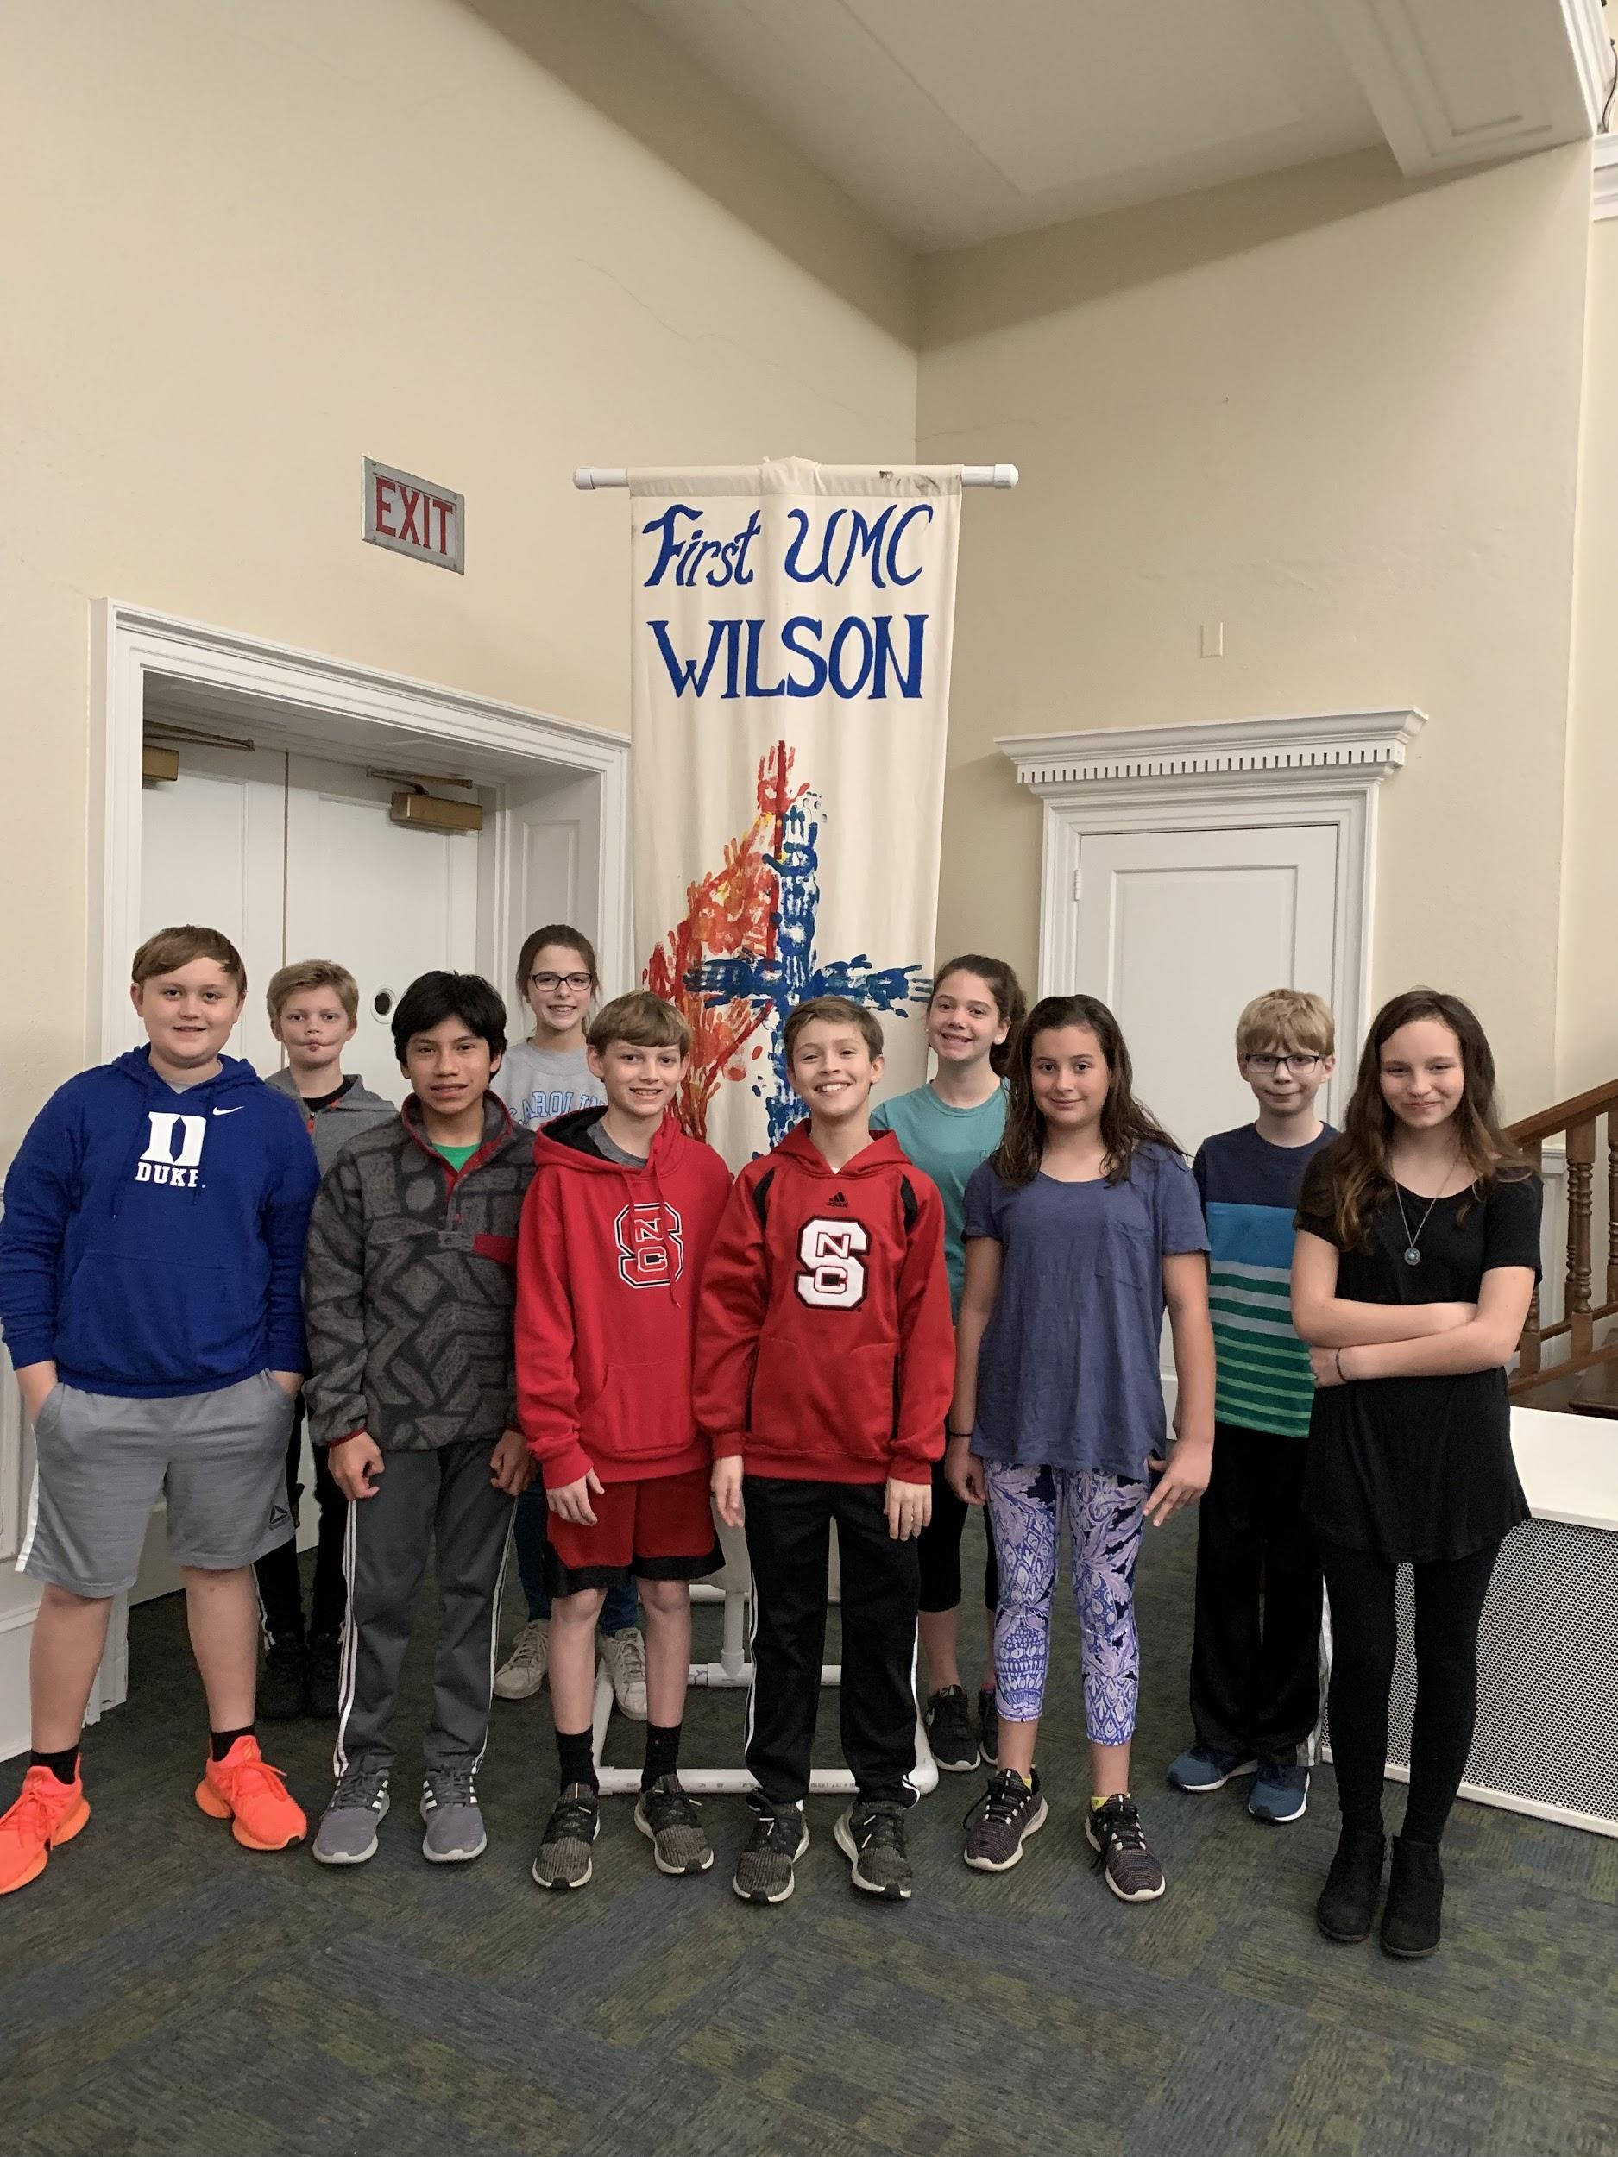
The Safe Sanctuary Policy is a comprehensive and holistic effort for the benefit of the entire FUMC congregation as well as all visitors and participants in our programs and events. Every staff member and volunteer will be expected to conduct his/her responsibilities and tasks with complete adherence to the guidelines outlined within our policy manual.

Slide 3
Baptismal Covenant
Members of the household of faith, I commend to your love and care these children (persons), whom we this day recognize as members of the family of God. Will you endeavor so to live that these children (persons) may grow in the knowledge and love of God, through our Savior Jesus Christ?

Slide 4
Response:
With God’s help, we will so order our lives after the example of Christ, that these children (persons), surrounded by steadfast love, may be established in the faith, and confirmed and strengthened in the way that leads to life eternal.

Slide 5
Following Safe Sanctuaries will help…
1. Protect the children, youth, and vulnerable adults in ALL ministry areas.
2. Protect our volunteers.
3. Reduce the liability for our church.

Slide 6
Safe Sanctuaries Training and Background Checks must be renewed every three years.
Two forms need to be completed and returned to our Children’s Director. Completion of a safe sanctuary quiz is also required and will be emailed to you.
Volunteer Covenant
FUMC Background Investigation Consent
Safe Sanctuary Quiz

Slide 7
Two Adult Rule
There will always be at least two unrelated adults present. This may include the presence of an adult “roamer” who moves in and out of the rooms.

Slide 8
Volunteer Requirements
Volunteers who serve as teachers and leaders of children will be at least 5 years older than the oldest person they are teaching or lead and at least 18 years old unless approved by the Director of Children’s Ministries or Director of Youth Ministries.
All adult volunteers involved with children, youth, or vulnerable adults of our church in a lead capacity, must have been a member or active participant of the congregation for at least six months before beginning a volunteer assignment.

Slide 9
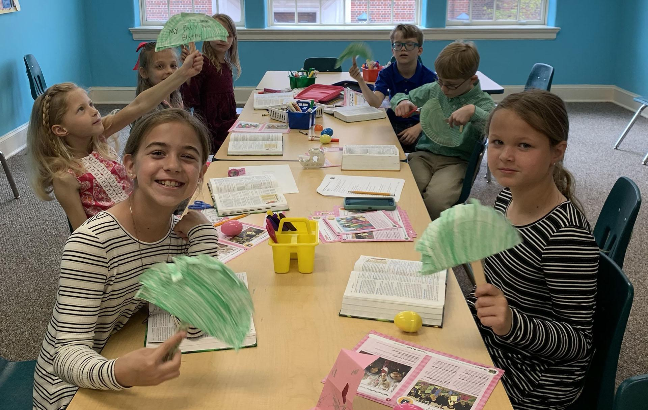
Children’s Division

Slide 10
Children’s Division
These procedures cover the activities of the Nursery/Children’s Ministry of First United Methodist Church. The Nursery division age is from birth to 4 years and the Children’s division is from Pre-K through 5th grade.

Slide 11
Drop off and Pickup
1. All parents or guardians leaving children in the nursery and children’s divisions shall follow these procedures to assure proper drop off and pickup.
2. All parents or guardians are to complete a Registration Form for their children which shall be kept on file with the Director of Children’s Ministries. The form will ask for the child’s name, parent(s) or guardian(s), home address, medical information (which should include allergies and medical conditions) and a cell phone number where the parent or guardian can be reached.
3. It is the responsibility of the parent or guardian to indicate to the Director of Children’s Ministries if there are any custody concerns regarding the release of the child, and, if this is the case, a copy of the custody order will be required.

Slide 12
4. All nursery children will wear a sticker (to be worn on the back of shirt) for identification. The parent/guardian will check in their child and verify all information is correct including a phone number where the parent can be reached.
5. Parents or other adults who bring children to FUMC are encouraged to remain on the property while their children are signed into FUMC ministries. Persons who leave the property while the children for whom they are responsible are signed into classes or events will provide emergency contact information. Parents of nursery age children are required to remain on the property.
6. The only person allowed to pick up a child will be the parent/guardian who dropped off the child unless other arrangements are made when the child is dropped off. In this situation, if the person picking up the child is unknown to the nursery/children’s division workers, he/she will need to show a picture identification to the workers.

Slide 13
7. Children not currently signed into a classroom or children’s event are the responsibility of their parents and must be attended to by their parents. Children must be supervised at all times while on church property.
8. Workers shall wear identification while working on campus in a ministry. This I.D. will be in the form of an official First Church name tag, special shirt, vest, etc. The I.D. will signify that the worker is approved under this policy.
Only trained, assigned workers/volunteers will be allowed in the nursery/children’s division rooms. No other individuals will be allowed in these areas without an identified need and the approval of the Director of Children’s Ministries.

Slide 14
Providing Adequate Personnel:
1. On-site programs that involve Nursery and Elementary age children will include supervisory personnel according to the ratios under the “Two Adult Rule.”
a. Children Infant through 2 Years of age 1 adult to 4 children
b. Children Pre-School (3-5 years) 1 adult to 8 children
c. Children Kindergarten - 5th Grade 1 adult to 12 children

Slide 15
2. Off-site programs that involve children will include supervisory personnel according to the following ratios:
a. Children Pre-school (3-5 years) 2 adults to 10 children max
3 adults to 15 children max
4 adults to 20 children max
b. Children Kindergarten - 5th Grade 2 adults to 16 children max
3 adults to 24 children max
4 adults to 32 children max
*No children under the age of 3 will be transported off site.

Slide 16
Weekday School Division

Slide 17
Weekday School Division
These procedures cover the activities in the First United Methodist Church Weekday School. The weekday school offers the following classes:
Creative Beginnings Toddlers - 23 Months
Little Learners 2 Years - 3 Years
Building Blocks 3 Years - 4 Years
Explorers 4 Years - 5 Years
Trailblazers 5 Years - 7 Years

Slide 18
Drop Off and Pickup
1. All parents or guardians leaving children at the weekday school shall follow these procedures to assure proper drop off and pickup.
2. All parents or guardians are to complete an Enrollment Form for their children which shall be kept on file with the Director of Weekday School. The form will ask for the child’s name, parent or guardian, home address, medical information (which should include allergies and medical conditions), emergency contact, approved pick-up adults, and a cell phone number where the parent or guardian can be reached.

Slide 19
3. It is the responsibility of the parent or guardian to indicate to the Director of Weekday School if there are any custody concerns regarding the release of the child, and, if this is the case, a copy of the custody order will be required.
4. The only person allowed to pick up a child will be the parent/guardian or individuals listed on the Enrollment Form, In this situation, if the person picking up the child is unknown to the preschool staff, he/she will need to show a picture identification to the workers.

Slide 20
Providing Adequate Personnel:
1. On-site programs that involve preschool age children will include supervisory personnel according to the following ratios under the “Two Adult Rule”
a. One-Year-Olds 2 adults to 10 children
b. Two-Year-Olds 2 adults to 12 children
c. Three-Year-Olds 2 adults to 14 children
d. Four-Year-Olds 2 adults to 16 children
d. Five-Year-Olds 2 adults to 16 children

Slide 21
2. Off-site programs that involve weekday school children will include supervisory personnel according to the following ratios:
a. Weekday School Children (3-7 years) 2 adults to 10 children maximum
3 adults to 15 children maximum
4 adults to 20 children maximum
*No children under the age of 3 will be transported off site.

Slide 22
Rules of Behavior
A. Two Adult Rule - Whenever possible, a minimum of two workers shall be present during any children’s activity. We will strive to never have a worker alone with any children. This two adult rule overrides all adult to child ratios. This may include the visible presence of an adult roamer.
B. Open Door Policy - All children’s classrooms will have either a viewing window that will remain free of covering or a dutch door where the top door will remain open at all times. In the event that a room does not have either a dutch door or viewing window, that door will always be unlocked and accessible.

Slide 23
C. Visible Presence - Every effort will be made to have someone present in the hallways during classes or events. This person will act as a visible presence in support of workers, as well as a deterrent to any potentially harmful situations for out children.
D. Restroom Policies - In situations where an escort is needed for a trip to the restroom a worker will stand outside the restroom and only assist a child if needed. Whenever a worker is in the restroom with a child, the door will remain open. The worker will never be in a closed-door situation with a child. If a child soils themselves during Sunday School, every attempt will be made to locate a parent. If a parent is unable to be located, two adult volunteers will be present while cleaning up the child.

Slide 24
E. Discipline - Corporal punishment, of any kind, is never appropriate. Teachers are asked to redirect a child if they should display inappropriate behavior. In the event that redirection does not work, a child will be separated from the group but remain in the same room and placed in a time out for a short period of time. If further action is needed, the child will be taken to the Director of Children’s Ministries or the Director of Weekday School and, if necessary, the child’s parent/guardian will be contacted.
F. Injury - Injuries requiring on-site first aid will be reported to the parent and Incident Report Form will be completed.

Slide 25
Touching to comfort or affirm a child in an age appropriate manner is permitted. Side-by-side hugs are suggested instead of full body contact. Appropriate touching need not be completely avoided but is acceptable only in public. Workers shall be aware of how it looks and how the person being contacted may interpret the contact.

Slide 26
Overnight Activities
The Weekday School and Children’s Divisions currently do not have overnight activities. Please refer to Safe Sanctuaries Manual if they are scheduled in the future.

Slide 27
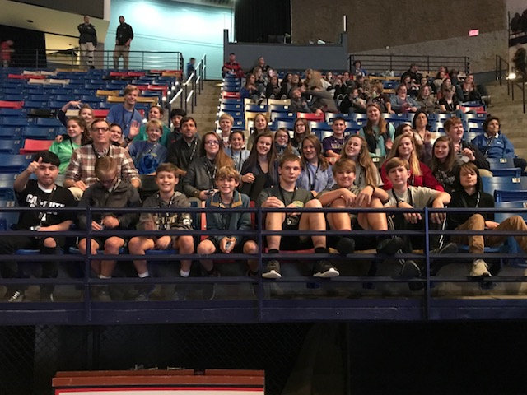
Youth Division

Slide 28
Youth Division
These procedures cover the activities of the Youth Division at First United Methodist Church. Children are placed in the Youth Division beginning 6th grade through the summer after 12th grade.

Slide 29
Supervision of Youth
Supervision ratios of youth and adults (under the 2-adult rule)
A. For safety purposes, with high school and middle school students there will be, whenever possible, one adult for every seven youth.
B. For purposes of supervising youth, an adult is defined as anyone who is at least 23 years old. Anyone under the age of 23 must be approved by the church staff before being allowed to be used in a leadership position.
C. Volunteers and staff should be responsible for no more that 7 minors at any given time, regardless of age.

Slide 30
Responsibility Times for Youth Ministry Workers
1. The youth ministry is not responsible for youth at times when no youth ministry offerings are scheduled.
2. The youth ministry is not responsible for youth who are supposed to be involved in youth activities who choose not to participate in the youth offerings as scheduled. Their parents will be contacted to pick them up when they choose not to participate.

Slide 31
Guidelines for Counseling in Informal
and/or Individual Settings
A. Same sex counseling is encouraged. However, ministry priorities and immediate circumstances may make same sex counseling unfeasible. When occasions of other than same sex counseling occur, a youth worker should seek to abide by the 2-adult rule.
B. In a situation where the 2-adult rule is not feasible, a youth worker is expected to move him/herself and the youth he/she is counseling towards the rest of the group, in hope of finding a second adult or notify another leader when/where the open-door conversation is being held.
C. The youth ministry has an interest in helping youth and youth ministry workers maintain appropriate boundaries. Youth workers need to communicate clearly at all times the message “I am your friend, but I am not your peer.”

Slide 32
Procedures for
Overnight Activities
These procedures cover youth activities which require an overnight stay and are sponsored by First United Methodist Church. This includes, but is not limited to, camping, lock-ins, hotel/motels, and overnight stays in personal dwellings.

Slide 33
Procedures for Overnight Activities
A. Approval: a signed parent/guardian permission form will be required of each youth prior to the activity. These will be collected and approved by the group leader prior to the activity. Following the activity, the forms will be given to the Director of Youth Ministries.
B. All overnight or off-property activities require prior permission of the Director of Youth Ministries.
C. Providing adequate personnel: programs that involve youth will include supervisory ratio of 1 adult to 10 youth following the 2-adult rule.

Slide 34
Rules of Conduct for Overnight Activities
A. All persons are to abide by the Safe Sanctuary Policies and Procedures.
B. None of the youth will be allowed away from the designated overnight area without prior permission of the group leader and the parent’s signed permission.
C. No members of the opposite sex will be allowed to sleep in the same room unsupervised.
D.The Youth Covenant must be signed by the youth and their parents before being allowed to participate in overnight activities.
E. Adults will not be allowed to sleep in the same bed with a youth unless the youth is their child and of the same sex. (This rule allows for the rare instance when this is necessary on youth ski trips or other similar events.)

Slide 35
Prohibited Behavior (all areas)
The following behaviors are prohibited for workers:
A. Threatening or intentionally inflicting emotional or physical injury
B. Committing any sexual offense or engaging in any sexual contact, including any kind of sexual offense or engaging in any sexual contact, including any kind of sexual advance or making a request for sexual favors, engaging in verbal, visual or physical conduct of a sexual nature, e.g. back rubs, massages, kissing, or similar behavior
C. Physical discipline, such as spanking
D. Discrimination of any type

Slide 36
Our church will not tolerate any behavior that is classified under the definition of bullying, and to the extent that such actions are disruptive, we will take steps needed to eliminate such behavior.
Bullying is aggressive behavior that is intentional, is repeated over time, and involves an imbalance of strength. Bullying can take on various forms, including:
Physical bullying - when one person engages in physical force against another person, such as hitting, punching, pushing, kicking, pinching, or restraining another.
Verbal bullying - when someone uses their words to hurt another, such as by belittling or calling another hurtful names.
Nonverbal or relational bullying - when one person manipulates a relationship or desired relationship to harm another person. This includes social exclusion, friendship manipulation, or gossip. This type of bullying also includes intimidating another person by using gestures.

Slide 37
D. Cyberbullying - the intentional and overt act of aggression toward another person by way of any technological tool, such as email, instant messages, text messages, digital pictures or images, or website postings (including blogs). Cyberbullying can involve:
Sending mean, vulgar, or threatening messages or images.
Posting sensitive, private information about another person.
Pretending to be someone else in order to make that person look bad.
Intentionally excluding someone from an online group.
Hazing - an activity expected of someone joining or participating in a group that humiliates, degrades, abuses, or endangers that person regardless of that person’s willingness to participate.
Sexually bullying - when bullying involves behaviors that are sexual in nature. Examples of sexualized bullying behaviors include sexting, bullying that involves exposures of private body parts, and verbal bullying involving sexualized language or innuendos.
Anyone who sees an act of bullying, and who then encourages it, is engaging in bullying. This policy applies to all members, staff and volunteers.

Slide 38
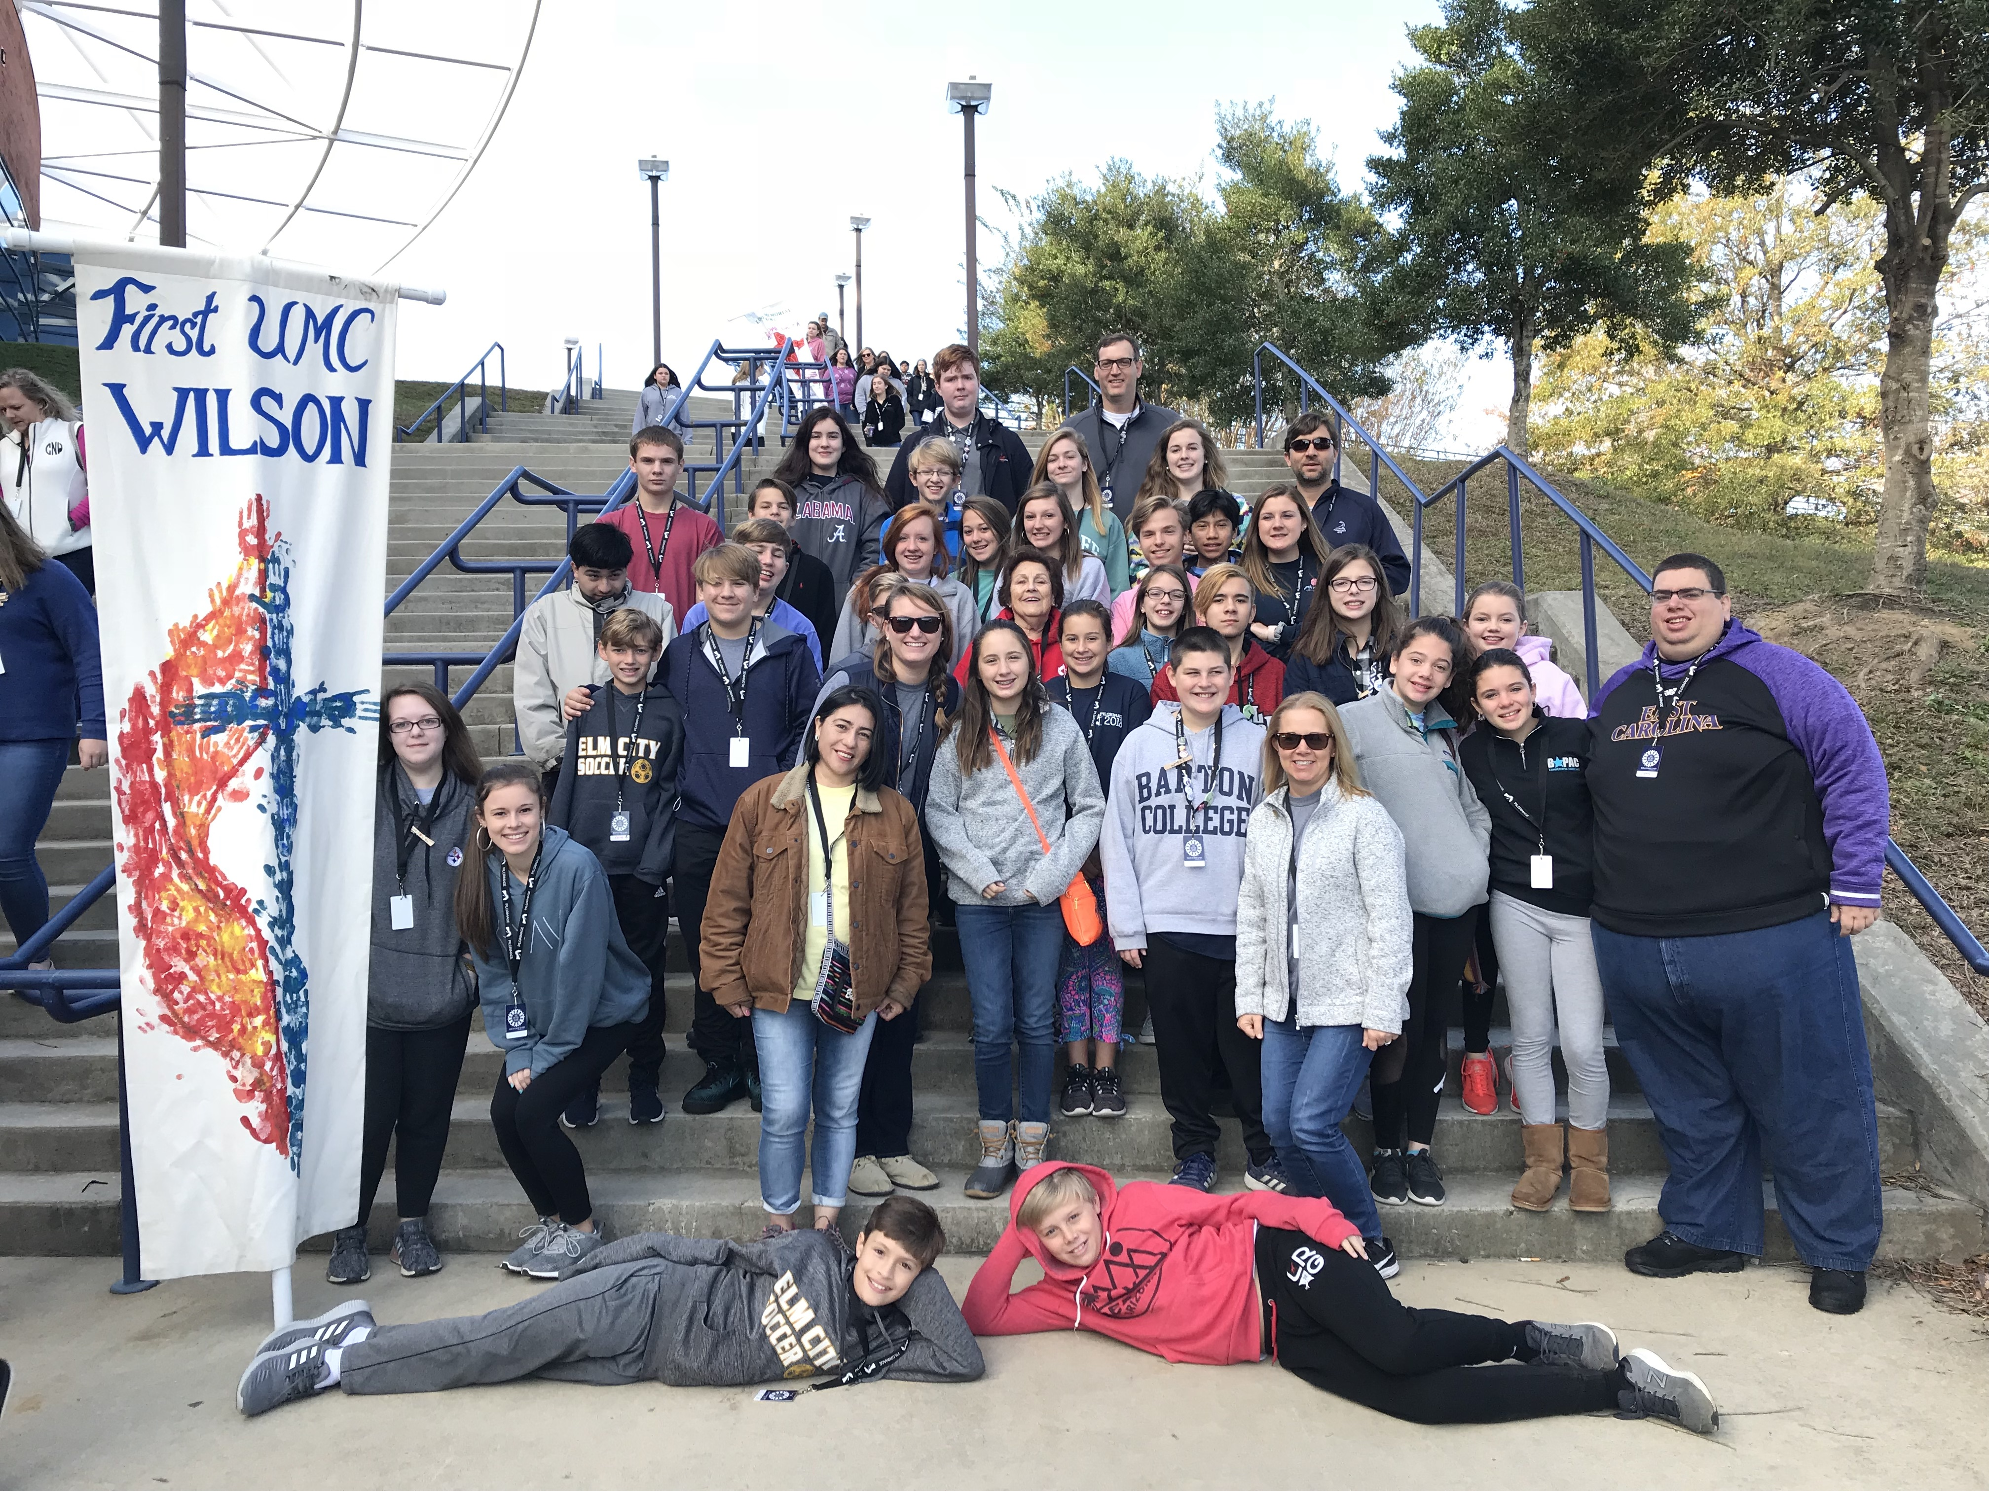
Transportation
(all areas)

Slide 39
Transportation
The following procedures are for providing transportation for children and youth to and from activities sponsored and/or supervised by First United Methodist Church. These procedures relate to transportation provided by the church, parents of children/youth, and children/youth workers to and from activities off the church property.

Slide 40
Transportation Procedures - Vehicle Requirements
1. These vehicle requirements pertain to vehicles owned by First United Methodist Church, those provided by parent or participating children, those provided by children/youth workers and any external commercial vehicles provided for transportation of children/youth.
2. All vehicles shall be in good running order, have a current valid license plate, inspection sticker, and passenger restraints. The passenger restraints must be used while transporting children/youth. If the child requires a booster seat per NC state law, it is the parents’/guardians’ responsibility to provide one.
3. All vehicles shall have insurance coverage required by North Carolina law.

Slide 41
Transportation Procedures - Qualifications for Drivers
1. All drivers will be workers (as qualified by the Safe Sanctuary Policy), parents of participating children/youth, or licensed commercial drivers. The Director of Children’s and/or Youth Ministries will pre-approve drivers.
2. All drivers will have a current valid driver’s license with the classification for the vehicle being driven and be at least 25 years of age, unless he/she is a staff member of the church.
3. All drivers who are staff members will be subject to periodic checks of their motor vehicle records.

Slide 42
Transportation Procedures - General Rules
1. Unless otherwise approved by the administrator and the parents/guardians, all transportation subject to these procedures will begin and terminate at the church property.
2. All drivers will obey all traffic laws. Failure to do so may disqualify them from driving for church related activities.
3. For overnight church functions, signed parent permission forms will be obtained from each child/youth prior to being allowed in any of these vehicles. If the child/youth does not have a completed permission form, he/she will not be permitted to participate in the transportation provided by the church. The permission forms are to be collected and checked by the group leader prior to leaving the church property. Upon return to the church, the forms will be given to the Director of Children’s and/or Youth Ministries.

Slide 43
4. No driver is to transport any child/youth alone without written or verbal permission from the parents. If possible, there will always be more than one child/youth in the vehicle. In the event there is one child/youth in the vehicle, the minor must be seated in the rear seat of the vehicle.
5. Preschool staff will not be responsible for transporting children. In the event of off-site activities outside of walking distance, the parent, guardian, or another adult authorized by the parent/guardian will be responsible for transporting their child to and from the site.

Slide 44
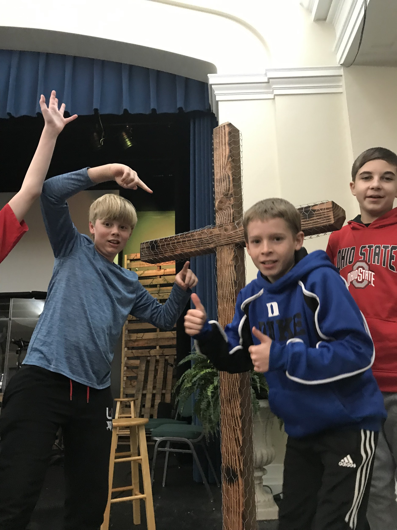
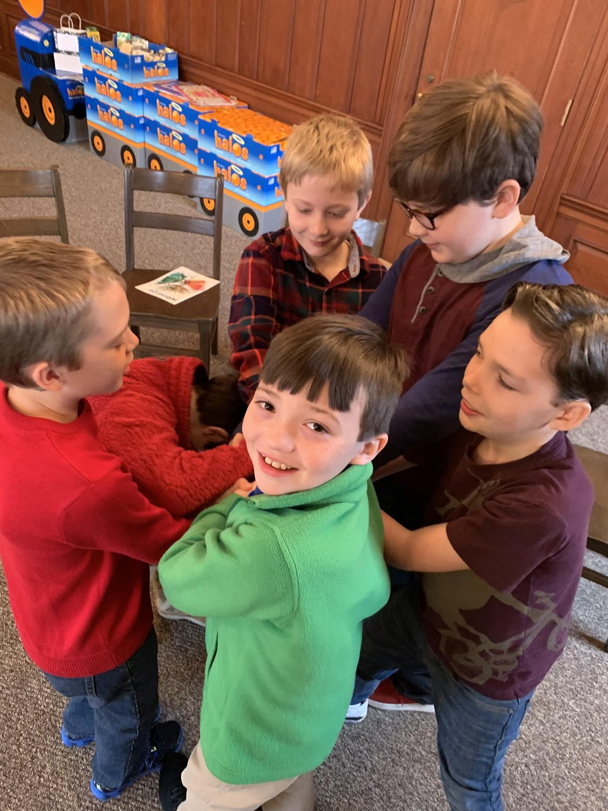
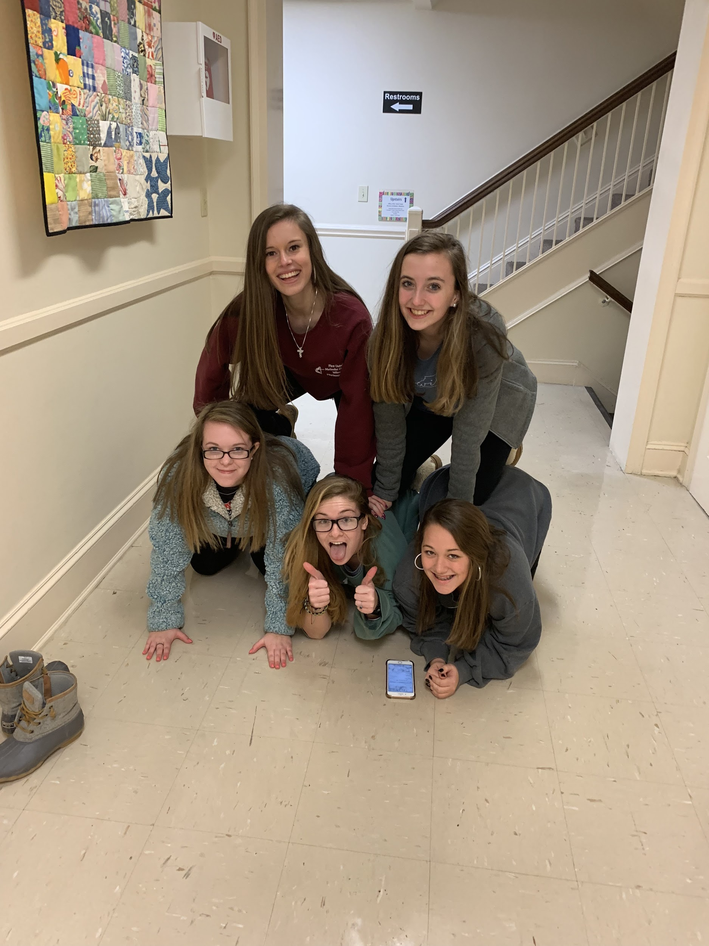
Awareness And Reporting

Slide 45
Be aware of evidence of abuse:
• Physical signs
• Emotional signs
• Neglect
• Sexual abuse
• Spiritual abuse/neglect
• Financial abuse

Slide 46
Response and Reporting
Who must report
The North Carolina reporting law applies to every person and every institution in the state. Do not ignore any reported incident of abuse. The law requires any person or institution who has cause to suspect that any child has been abused or neglected, to make a report to the county department of social services (NC G.S. 7B301).

Slide 47
Reporting
Having “cause to suspect” child abuse or neglect is not just a feeling about a situation alone. It is important that it is connected to something observable or disclosed, such as a child’s statements, behavior, or appearance. Legal definitions of abuse and neglect are important, but anyone concerned about a child but confused about whether their concern is reportable or not should make the report. Child Protective Services (CPS) Social Workers are trained to assess the presenting information and determine whether a report needs to be taken. If CPS determines that the report does not need to be handled by them, they will automatically forward a report to local law enforcement for investigation. If the report is made in good faith, there is not liability risk in reporting. So, if in doubt, report.

Slide 48
A person who has cause to suspect a child is being abused or neglected has no duty to conduct an investigation to uncover evidence for the report. In fact, that could interfere with a Child Protective Services investigation. He or she is not required to have detailed knowledge of the abuse to make the report.
If other church officials are notified prior to a report being made to the Department of Social Services, that notification must be intended as communication and awareness for the church and not as a process of screening the reporting.

Slide 49
Steps to be taken
Ensure the physical safety of the child/youth
Do NOT confront the accused adult
Notify the appropriate personnel by phone or in person
If the allegation is against a volunteer, notify the Director of Youth Ministries, Director of Children’s Ministries, or Director of
If the allegation is against an employee, notify the Senior Pastor, Director of Youth Ministries, Director of Children’s Ministries, or Director of Weekday School
If the allegation is against a pastor, notify the Director of Youth Ministries, Director of Children’s Ministries, or Director of Weekday School
Independent of that notification, a report to Child Protective Services (CPS) will be made by the person who received the allegations.

Slide 50
Include as much of the following in the report to CPS as possible:
Child’s name, age and address
Name and address of the child’s parent, guardian, or caretaker
The names and ages of other children in the home
The child’s location if not at the home address
The nature and extent of any injury or condition resulting from the abuse or neglect
Any other information that might help establish the need for protective intervention
Volunteers will be relieved of duties pending a DSS (Department of Social Services) or law enforcement investigation.
Allegations will be reported appropriately and if necessary, additional steps will be taken. (see full policy)

Slide 51
If the allegation is against someone outside the church (parent, caregiver, or individual):
Do not restrict the child from leaving with the parent.
An immediate report to Child Protective Services is to be made by the person who received the allegations.
Notify the Director of Youth Ministries, Director of Children’s Ministries, or Director of Weekday School
Allegations will be reported appropriately and if necessary, additional steps will be taken. (see full policy)
Documentation, documentation, documentation!
(forms in the online training manual)

Slide 52
Response for Abuse
The following steps shall be taken once abuse is reported:
A response team shall be formed and will be assigned to take any further actions that are required. The response team shall follow the advice of legal counsel and the District Superintendent (or the District Superintendent’s representative).
The Response Team shall be made up of the Senior Pastor, the Chairman of the Staff Parish Relations Committee Chairman, the Church Council Chairperson, and a mental health professional.
The Response Team shall appoint one sole media spokesperson. The Response Team shall determine the appropriate means of communicating with the congregation.

Slide 53
The Response Team will:
Inform the employee or volunteer of the accusation.
Suspend with pay (for paid employee) the alleged offender while the confidential investigation is being conducted.
Consult with the church attorney.
Reassure the victim that he or she has done nothing wrong and that it was right to report the incident.
Allow the victim to speak freely.
Not coach responses from the victim and will do not become defensive to any statements.
Cooperate in the investigation conducted by the insurance company and Child Protective Services.CPS and the insurance company.
Provide ongoing spiritual and counseling support for the victim and his/her family.
Consider the spiritual needs of the accused and seek assistance from the District Superintendent and Conference personnel in providing for proper counseling and response for the accused and the accused’s family.
Use response team to ensure all necessary steps were followed, reports made, and documentation completed.
Review the process to see if improvements need to be made in policy or procedure.
* See policy for Notification Contacts

Slide 54
Post Reporting Procedure
First United Methodist Church acknowledges that there are many victims beyond the abused who may be affected by an incident or of suspicion of child abuse or neglect. We are mindful that the following persons will require the proper response, care, counseling, and support following any such event.
Family members of the harmed child or youth
Peers of the child or youth
Peers of the child’s or youth’s parents
Remaining child/youth workers
Congregation as a community of faith
Family of the accused abuser

Slide 55
We believe that failure to address the issues of suffering, anger, fear, and grief that occur within the church after abuse can have extended and unnecessary consequences for everyone. We will not hide nor shrink away from our responsibility to promptly and appropriately address any incident of abuse. As a congregation, we will be committed to the prevention of and termination of behaviors which contribute to the cycle of abuse. The following represents the steps we will take to assure that the congregation and those affected may be restored to a feeling of well-being and justice.
First: Truth telling is the most important component in post-lost post-loss recovery. Our communications will be honest, measured and respectful of all parties involved. Written communication shall be factual and will work to dispel rumor and innuendo and to assure the congregation of the efforts taken to secure the safety of the victim and to resume the functions of ministries and programs.

Slide 56
Second: Senior clergy will host a planned congregational meeting so that members can attend to learn about the church’s response to the allegation of abuse. The meeting will be led by appropriate senior clergy, lay leaders, and the District Superintendent. A non-member Counselor will be available to address attendee questions and feelings.
Third: A task force will be established to determine how FUMC will adapt its ongoing ministries to appropriately acknowledge and recover from the incident. Educational programs in various forums (Wednesday night classes, Adult Sunday School Curriculum, Youth, etc.) will be implemented to promote healing, justice, education, and restored worship.
Fourth: The Safe Sanctuary Committee will work closely with the Task Force response team and clergy to modify any procedure and policies based upon incident outcomes and to will diligently engage in every effort to prevent further incidents of abuse or neglect.

Slide 57
Additional information regarding documentation and a copy of the incident report can be found in
our full policy.
Thank you for being a part of the ministries of
FUMC Wilson!
Feedback and Questions
Email Vickie Franks, Director of Children’s Ministries, at vickiebfranks@fumcwilson.org or Tiler Bland, Director of Youth Ministries, at tilerbland@fumcwilson.org.

Slide 58
Safe Sanctuary Quiz
Please check your email for a link to a short safe sanctuary quiz. In order to show completion of this course you must take the quiz.
Thank you.
Don’t forget to print, sign and return the Volunteer Covenant and Background Authorization Forms. The Safe Sanctuaries Manual and forms can be found on our church website by clicking the link below.
http://fumcwilson.org/ministries/safe-sanctuaries

